Slide 1

STOCK MARKET
Real-Time Data Analysis Using Kafka

Slide 2
Team working on this
Mamatha Peddamala : Storytelling and Data Visualization Expert - Creates visualizations and narratives to communicate insights effectively
Sirisha Kasetty : Team Leader - Oversees project management and coordination
Likith Kagita : Data Scientist - Responsible for data analysis, modeling, and algorithm development
Venkatesh Swarna: Data Engineer- Focuses on building and optimizing streaming data pipeline

Slide 3
The Problem
Problem #1 Real-time analysis of stock market data poses several significant challenges due to the high volume, velocity, and variety of data.
.
Problem #2 The stock market is highly dynamic and influenced by various factors such as news, economic indicators, and investor sentiment.
.
Problem #3 Analyzing this data in real-time to identify trends, patterns, and opportunities requires sophisticated data processing and analysis techniques.
01
02
03

Slide 4
The Solution
Solution #1 Scalable Data Infrastructure:
We will deploy Apache Kafka as our distributed messaging system to handle high volumes of streaming data efficiently.
By leveraging Kafka's partitioning and replication features, we ensure fault tolerance and scalability across multiple nodes.
Solution #2 Data Integration and Enrichment:
We will integrate various data sources, including financial APIs, news feeds, and economic indicators, to capture a comprehensive view of market dynamics.
01
02

Slide 5
Market Size
2010
55T
The market size for real-time analysis of stock market data is rapidly growing from 2010.
41T
2005
32T
In 2005, the market size for real-time analysis of stock market data experienced significant growth compared to previous years.
2000
In 2000, the market size for real-time analysis of stock market data was relatively smaller compared to recent years

Slide 6
Business model / Plan
Implement monitoring and alerting mechanisms to track data quality metrics, processing errors, and pipeline performance.
Data Quality Monitoring and Assurance:
Develop data orchestration workflows to automate data processing tasks, scheduling, and monitoring.
We will define the project objectives, which include identifying market trends, predicting stock prices, and detecting anomalies in trading patterns.
Data Integration and Orchestration
Business Understanding
Our Plan
Choose appropriate storage technologies for storing processed data. Design data schemas and structures optimized for query performance, scalability, and data access patterns.
Identify the sources of data required for analysis, such as databases, APIs, logs, files, or streams.
Data Storage and Management
Data Collection
Design data processing pipelines to clean, transform, and enrich raw data into a usable format for analysis
Data Processing

Slide 7










Data Source
App Simulation
Streaming Platform
AWS Services
Visualization
Repository

Slide 8
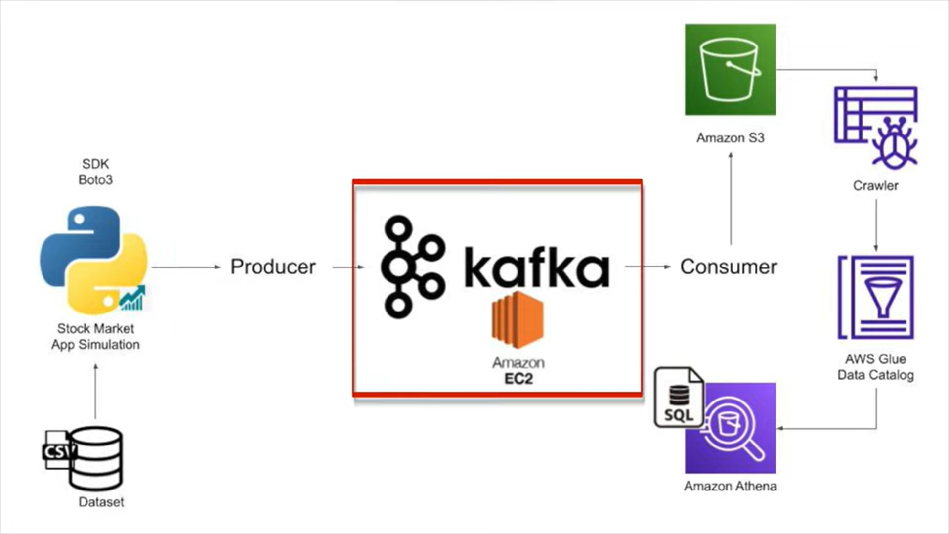
Technology/Expertise

Slide 9
Measuring Success
How will we define & measure success?
Cleaning and Wrangling Data cleaning involves handling missing values, outliers, and inconsistencies in the raw data.
Data wrangling involves transforming and structuring the data to make it suitable for analysis.
.
Management Utilize Apache Kafka as the central data streaming platform and to
Implement data pipelines for efficient data management, including data ingestion, transformation, and storage.
Sources Real-time stock market data from financial APIs, data feeds, or directly from stock exchanges.

Slide 10
Roadmap, Metrics Milestones
Milestone #1
Accuracy: Compare the data values against known ground truth or reference data.
Milestone #2
Latency - Evaluate the time taken for data to move through the entire pipeline from source to destination.
Milestone #3
Scalability – Assess the system's ability to handle increasing data volumes and growing user demands without performance degradation.

Slide 11


